Slide 1
Data Structure and Algorithm
Course code: cs-201
Topic: Infix to postfix conversion- stacks
Instructor: habiba arshad

Slide 2
Goal for today
Reversal of Strings
Infix to postfix conversion using stack
evaluation of postfix expression

Slide 3
Practice Task
Write an algorithm to perform ‘push’ and ‘pop’ operations in Stack and by considering the following stack of city names, show the pictorial representation of stack as the below mentioned operations take place:
STACK: London, Berlin, Rome, Paris, _____, ______
Operations:
PUSH (STACK, Athens)
POP (STACK, ITEM)
POP (STACK, ITEM)
PUSH (STACK, Madrid)
PUSH (STACK, Moscow)
POP (STACK, ITEM)

Slide 4
Application of stacks
Reversal of strings.
Checking validity of brackets.
Converting infix to postfix and prefix.
Evaluating the postfix expression.

Slide 5
Checking expression validity
Total number of left parenthesis should be equal to number of right parenthesis in the expression.
For every right parenthesis in the expression there should be left parenthesis of the same type.
For example:
[19-5*(9+4)
(1+5}
[5+4*(9-2)]
Invalid
Invalid
Valid

Slide 6
Algorithm for reversal of strings
Create an empty stack.
One by one push all characters of string to stack.
One by one pop all characters from stack and put them back to string.

Slide 7
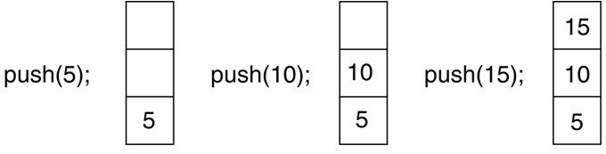
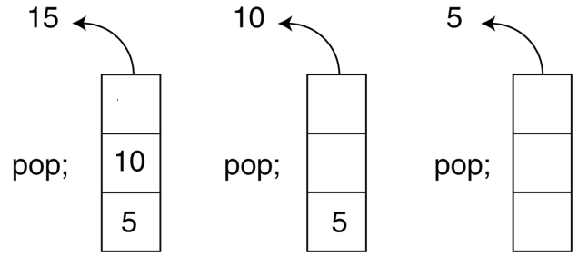
Push and Pop Operations on Stack
7

Slide 8
Reversal of string
Top/Index | Data
4 | A
3 | I
2 | R
1 | A
0 | M
Top/Index | Data
4 | M
3 | A
2 | R
1 | I
0 | A
8

Slide 9
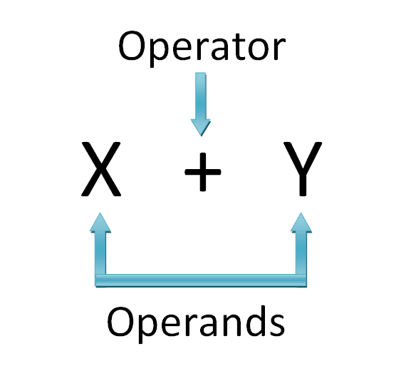
Algebraic Expression
An algebraic expression is a legal combination of operands and the operators.
Operand is the quantity on which a mathematical operation is performed.
Operator is a symbol which signifies a mathematical or logical operation.
9

Slide 10
Infix, Postfix and Prefix Expressions
An INFIX: expressions in which operands surround the operator. E.g. A+B
POSTFIX: operator comes after the operands, also Known as Reverse Polish Notation (RPN). E.g. AB+
PREFIX: operator comes before the operands, also Known as Polish notation. E.g. +AB
Example
Infix: A+B-C Postfix: AB+C- Prefix: -+ABC
10

Slide 11
Why do we need PREFIX/POSTFIX?
Appearance may be misleading, INFIX notations are not as simple as they seem
When you write an arithmetic expression such as B * C, the form of the expression provides you with information so that you can interpret it correctly.
In this case we know that the variable B is being multiplied by the variable C since the multiplication operator * appears between them in the expression. This type of notation is referred to as infix since the operator is in between the two operands that it is working on.
11

Slide 12
Why do we need PREFIX/POSTFIX?
Consider another infix example, A + B * C.
The operators + and * still appear between the operands, but there is a problem.
Which operands do they work on? Does the + work on A and B or does the * take B and C? The expression seems ambiguous.
Solve this problem using operator precedence rules
12

Slide 13
Why do we need PREFIX/POSTFIX?
Operators | Symbols | Associativity
Parenthesis | ( ), {}, [ ] | Left to Right
Exponents | ^ | Right to Left
Multiplication and Division | *, / | Left to Right
Addition and Subtraction | + , - | Left to Right
Operators of higher precedence are used before operators of lower precedence. The only thing that can change that order is the presence of parentheses. The precedence order for arithmetic operators places multiplication and division above addition and subtraction. If two operators of equal precedence appear, then a left-to-right ordering or associativity is used.
13

Slide 14
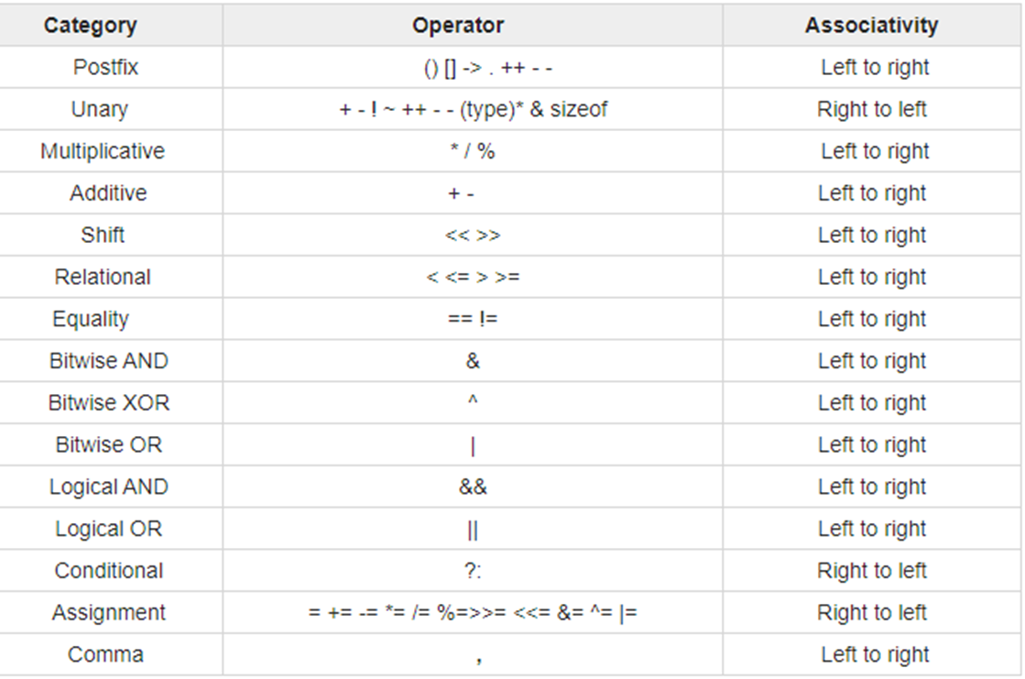

Slide 15
Why do we need PREFIX/POSTFIX?
To evaluate an infix expression we need to consider
Operators’ Priority
Associative property
Delimiters
15

Slide 16
Why do we need PREFIX/POSTFIX?
Infix Expression Is Hard To Parse and difficult to evaluate.
Postfix and prefix do not rely on operator priority and are easier to parse.
An expression in infix form is thus converted into prefix or postfix form and then evaluated without considering the operators priority and delimiters.
In polish notation we don’t have a need of any parenthesis and by scanning from left to right we can evaluate the expression one by one. There is no need of traversal in expression at different places for evaluation.
16

Slide 17
Rules to convert infix to postfix expression
Parse from left to right
Print the operand as they arrive.
If the stack is empty or contains a left parenthesis on top, push the incoming operator on to the stack.
If the incoming symbol is '(', push it on to the stack.
If the incoming symbol is ')', pop the stack and print the operators until the left parenthesis is found.
If the incoming symbol has higher precedence than the top of the stack, push it on the stack.
17

Slide 18
Rules to convert infix to postfix expression
If the incoming symbol has lower precedence than the top of the stack, pop and print the top of the stack. Then test the incoming operator against the new top of the stack.
If the incoming operator has the same precedence with the top of the stack then use the associativity rules.
If the associativity is from left to right then pop and print the top of the stack then push the incoming operator.
If the associativity is from right to left then push the incoming operator.
At the end of the expression, pop and print all the operators of the stack.
18
Notes:
No two operators having same priority can stay together in stack
Lowest priority cannot be placed before highest priority operator.

Slide 19
A+B*C in postfix
Applying the rules of precedence, we obtained
A+B*C
A+(B*C) Parentheses for emphasis
A+(BC*) Convert the multiplication,
ABC*+ Postfix Form
19
Notes:
https://www.javatpoint.com/convert-infix-to-postfix-notation

Slide 20
Examples of infix to prefix and post fix
Infix | PostFix
A+B | AB+
(A+B) * (C + D) | AB+CD+*
A-B/(C*D^E) | ABCDE^*/-
20

Slide 21
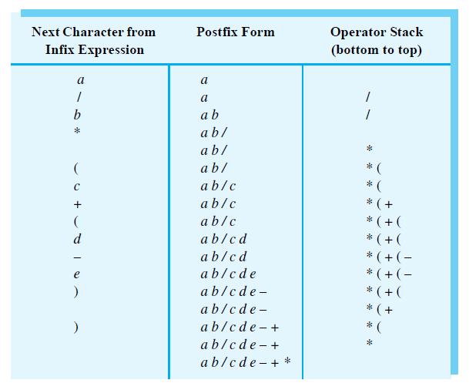
Infix to Postfix Conversion
The steps in converting the infix expression a / b * (c + (d - e)) to postfix form

Slide 22
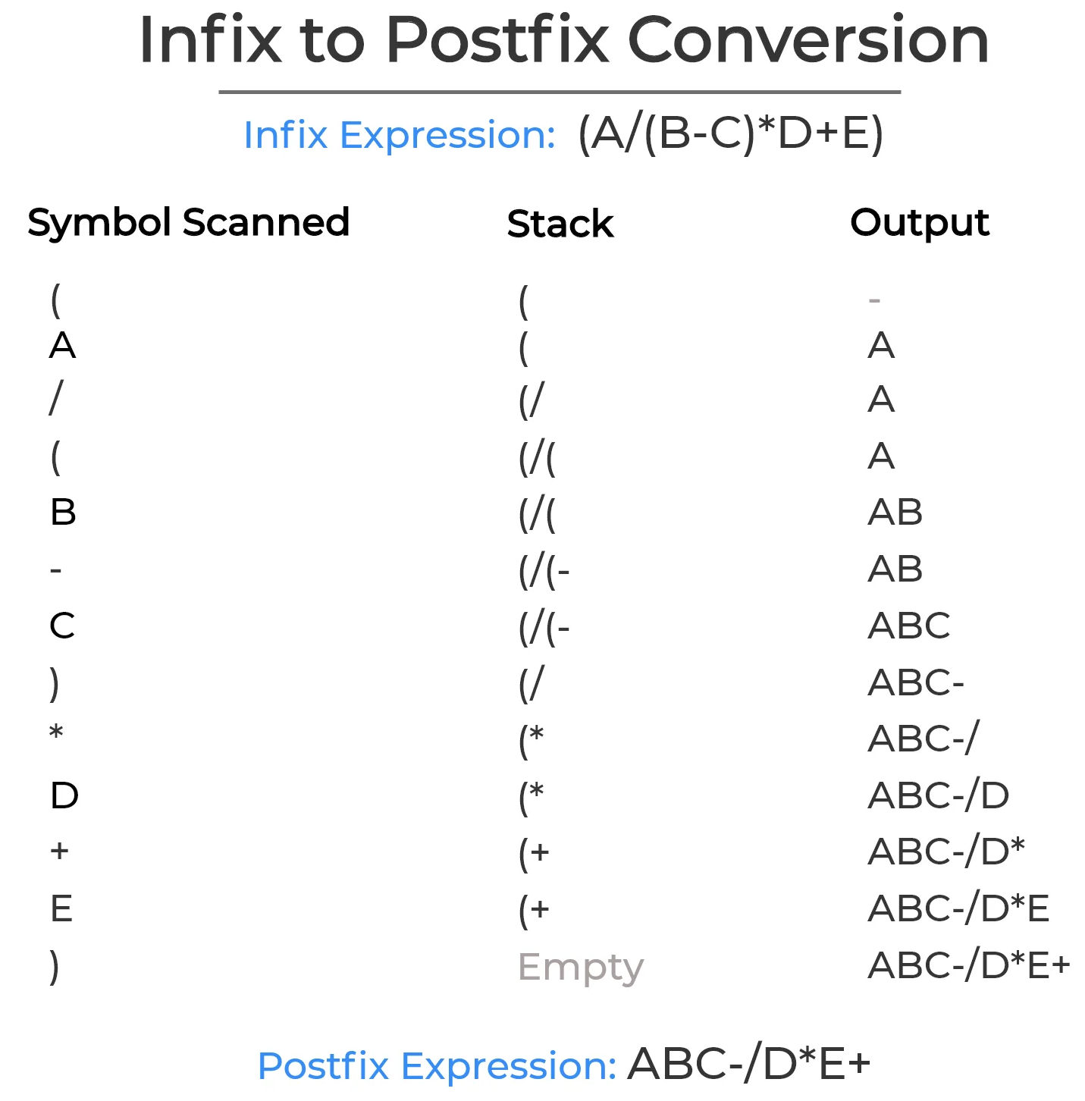
Infix to Postfix using stacks

Slide 23
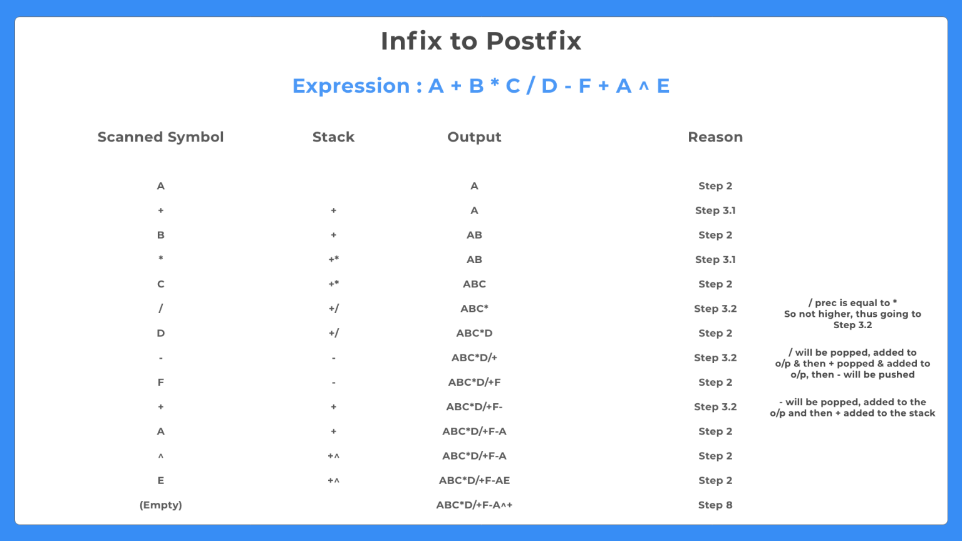
Infix to Postfix using stacks

Slide 24
Yours Turn
(A+B)/E*F+C
A*(B+D)/E-F*(G+H/K)

Slide 25
Q Translate infix expression into its equivalent post fix expression: (A-B)*(D/E)
Ans: (A-B)*(D/E) = [AB-]*[DE/] = AB-DE/*
Q. Translate infix expression into its equivalent post fix expression: (A+B^D)/(E-F)+G
Ans : (A+B^D)/(E-F)+G = (A+BD^])/[EF-]+G = [ABD^+]/[EF-]+G
= [ABD^+EF-/]+G = ABD^+EF-/G+
Q.Translate infix expression into its equivalent post fix expression:
A*(B+D)/E-F*(G+H/K)
Ans: A*(B+D)/E-F*(G+H/K) = A*[BD+]/E-F*(G+[HK/])
[ABD+*]/E-F*[GHK/+]
[ABD+*E/]-[FGHK/+*] = ABD+*E/FGHK/+*-

Slide 26
Algorithm for evaluation of postfix expression
Scan the expression from left to right.
If operand is encountered, then push it onto stack.
If operator is encountered, then pop the last two elements from stack.
b=stack[top], a=stack[top-1], c=a operator b.
Push the result ‘c’ back to stack.
Result is equal to the top value of stack.

Slide 27
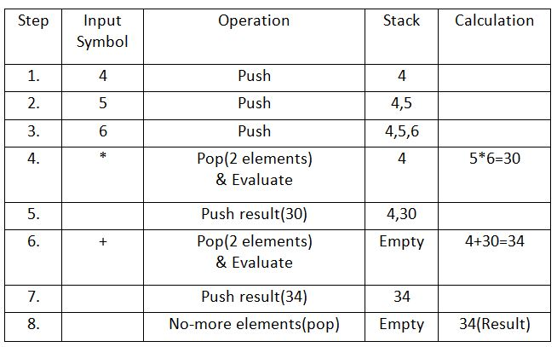
Algorithm for evaluation of postfix expression
Let the given expression be “456*+“. We scan all elements one by one.

Slide 28
Questions?

